Slide 1

Hotel Identification to
Combat Human Trafficking
Project 5
Amy Giver
Caleb Thomas
Grace Chang
Aderinsola Gilbert

Slide 2
The ISSUE
Human trafficking is the world’s third-largest criminal industry, trailing only the drug and weapons trade.
It is estimated that there are 20-40 million victims of human trafficking globally, with hundreds of thousands in the United States.
Notes:
.

Slide 3

PRoblem Statement
This March, TraffickCam launched a kaggle contest that tasked competitors with identifying the hotel seen in test images from the TraffickCam dataset.
McGruff LLC aims to build a model that can pinpoint specific hotel IDs within the 7,770 hotels present in the dataset.

Slide 4
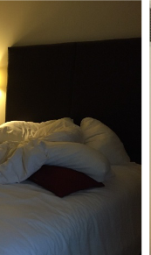
TrafficKCam
In 2016, the TraffickCam app was developed by the Exchange Initiative. The TraffickCam team efforts have been instrumental in aiding human trafficking investigations

Slide 5
DataSet
97,000+ images
7,770 hotels
88 unique Hotel Chains
Training Metadata
image - The image ID.
chain - An ID code for the hotel chain. The number of hotels per chain varies widely.
hotel_id - The hotel ID. The target class.
timestamp - When the image was taken. Provided for the training set only.
Dataset
Dataset

Slide 6
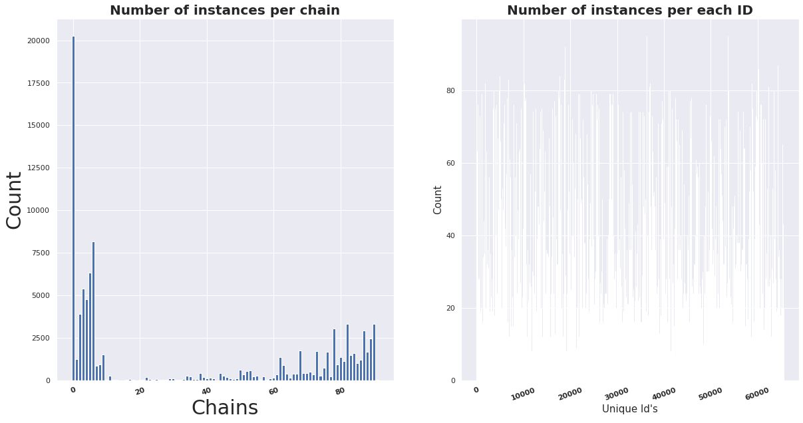
EDA

Slide 7
Observations
A chain of zero (0) indicates that the hotel is either not part of a chain or the chain is not known.
There is the issue of high intra-class variation - not every room will have shared objects and some rooms may have been renovated.
Conversely, there is also the issue of low interclass variation with hotels from the same chain.
Notes:
Images within the same hotel can differ greatly
Images from different hotels (especially those within the same chain) can be visually similar

Slide 8
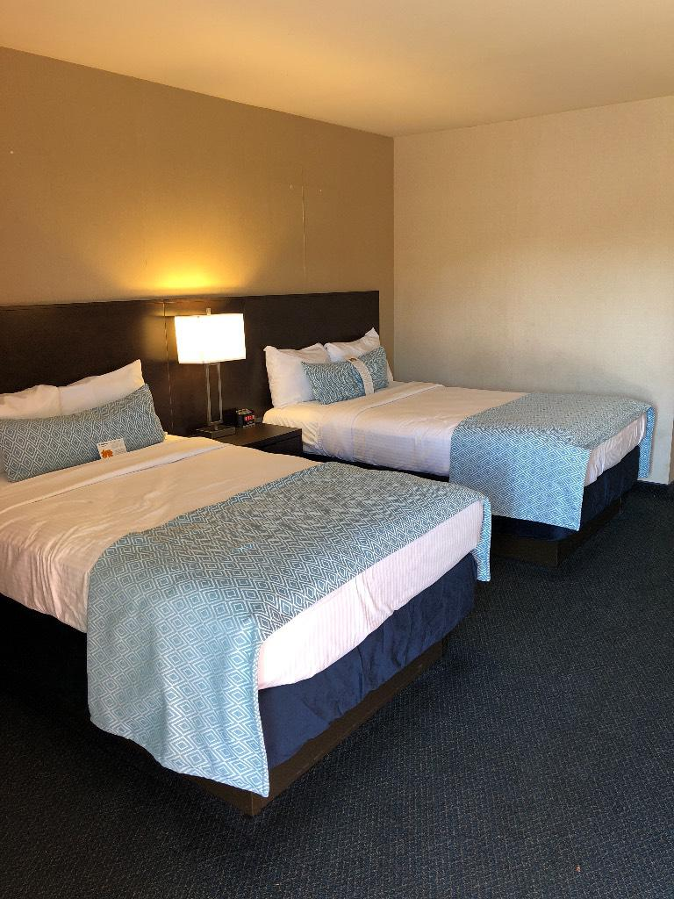
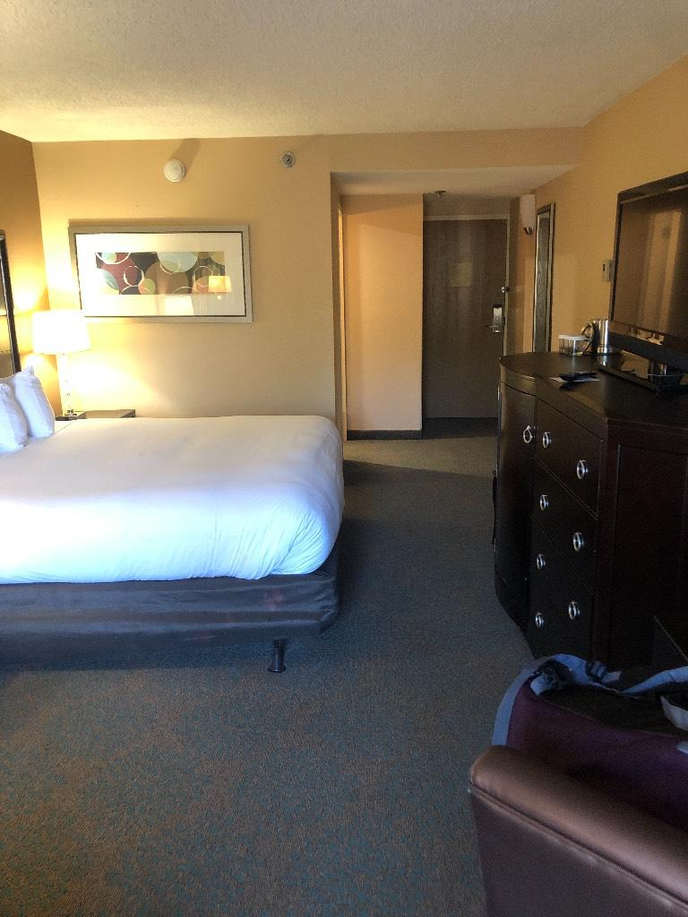
Outstanding features
Overall the model performed better when unique features (i.e blue sheets) were shown.
When tasked to predict 5 hotels these two rooms could have come from, its best guess at .36% confidence was correct for the hotel with the blue bedspread.
It failed to identify the second room, even with 10 guesses.
.
Notes:
A lot of hotel rooms look the same! A bed with white sheets.
The blue bed sheet seems to be helping our model
When tasked to predict 5 hotels these two rooms could have come from, the model’s first guess at .36% confidence was correct for the hotel with the blue bedspread.
For the other room, the correct guess did not even make the model’s top ten guesses.

Slide 9
Models USED
Fixed Scene Method - VGG model trained on the Places365 dataset (Clustering)
CNNs with augmented data and regularization

Slide 10
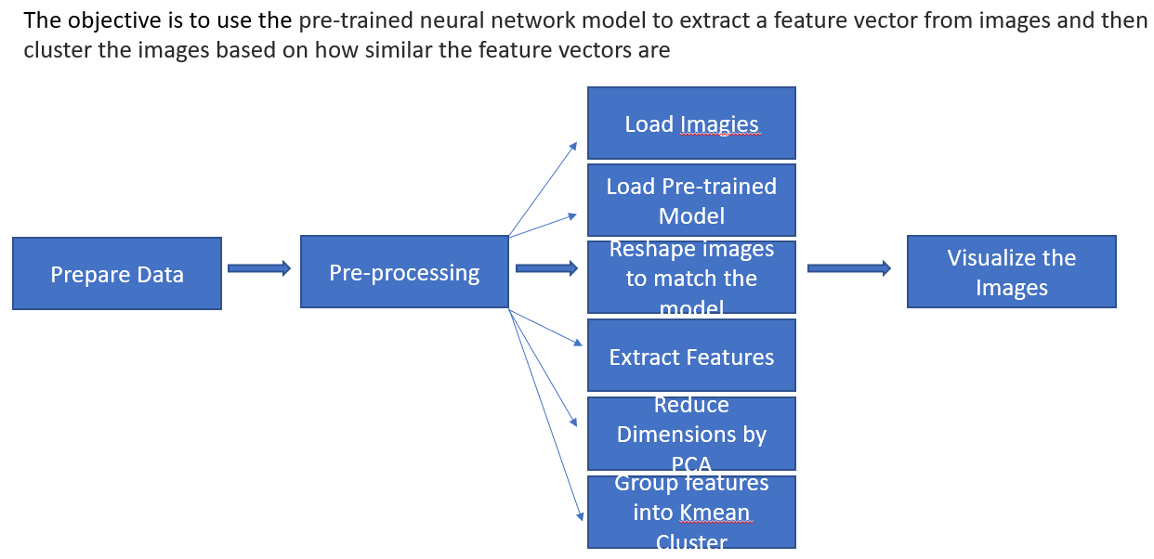
CLUSTERs
Load Images

Slide 11
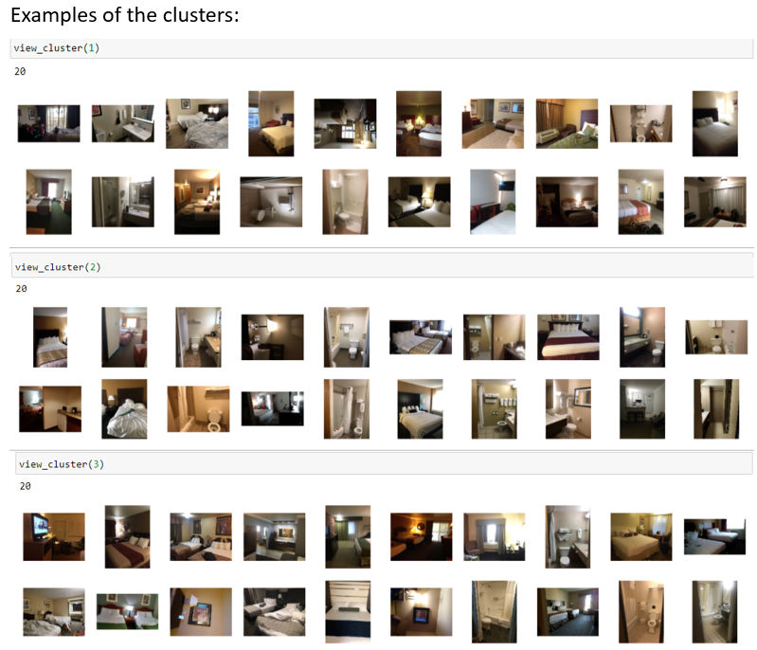
CLUSTERs

Slide 12
Strategy for cnn architecture
Input layer
Data augmentation
Conv2d layers
Dense layers
Dropout layers
Max Pooling
Resized, reshaped, and scaled
Rotate images, flip images, crop images...
Filters and kernel regularization
Weights and kernel regularization
Generalization
Cuz Andrew Ng says so

Slide 13
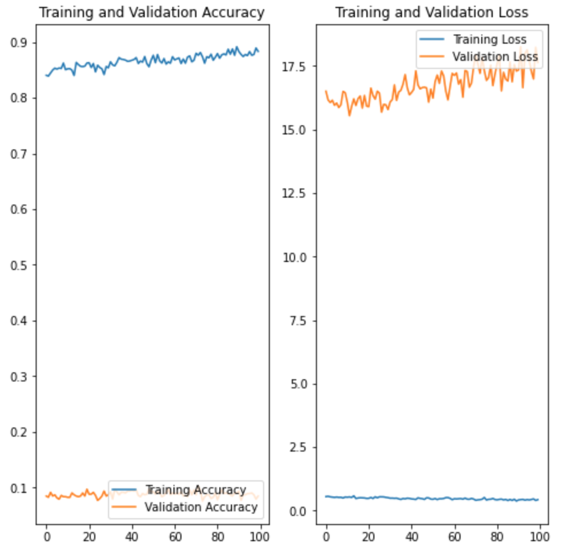
OVERFIT
It was pretty easy to teach the model to memorize pictures
Notes:
Training accuracy: 90%, Training loss: ~ 1
Validation accuracy: 10% , Validation loss: 18 and climbing
This validation accuracy was tough to beat though, as we will see coming up.

Slide 14
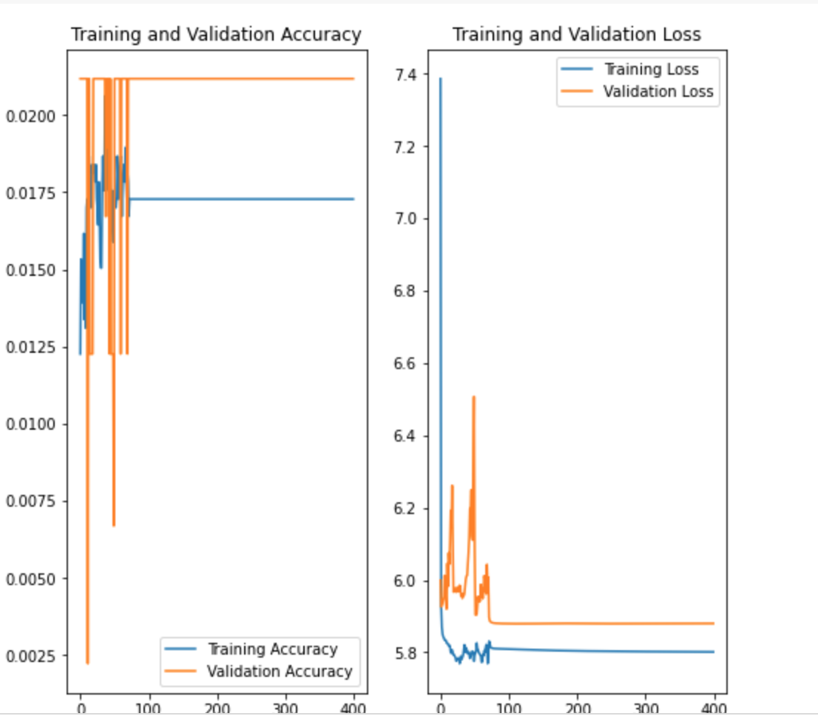
L2 regularization
We’re not overfit anymore!
Validation loss has come plummeting down!
However accuracy is around 2%
Notes:
Validation doing better than training
Training loss went up (from 1 to 5.8) but validation loss came plummeting down from 18
However everything flattens out, accuracy for validation is not rising beyond about 2.25%

Slide 15
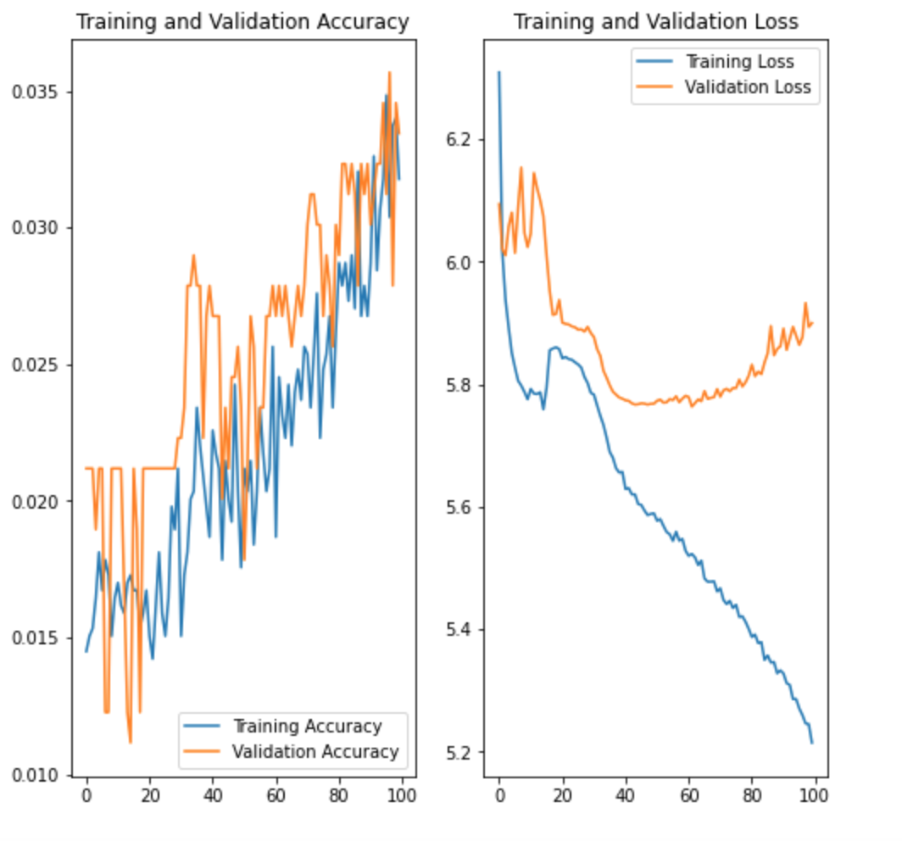
Data augmentation
Reduce l2 regularization
Create data by manipulating images in the dataset
Rotate, flip, zoom, crop

Slide 16
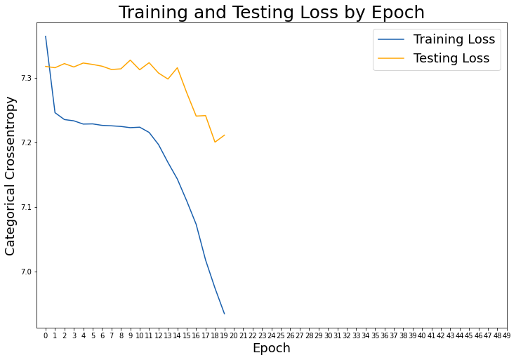
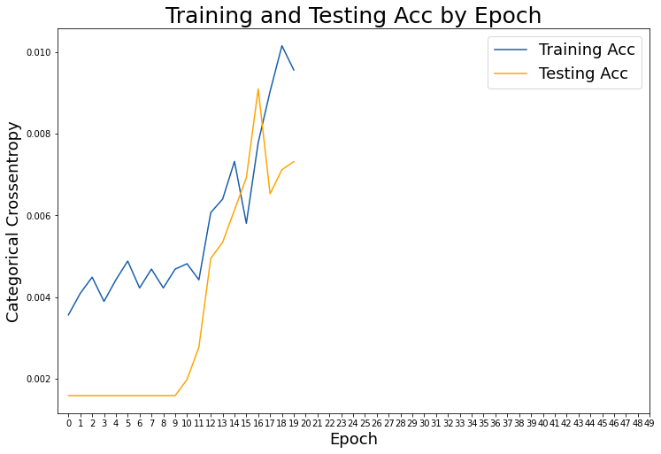
More MODELING
Accuracy
First 20 epochs

Slide 17
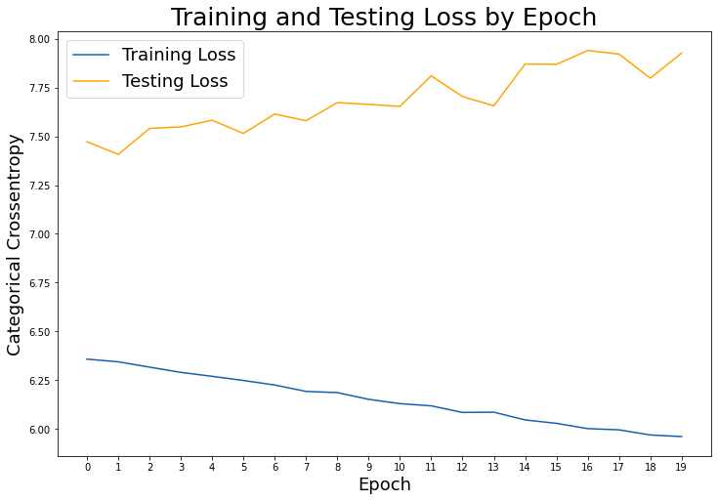
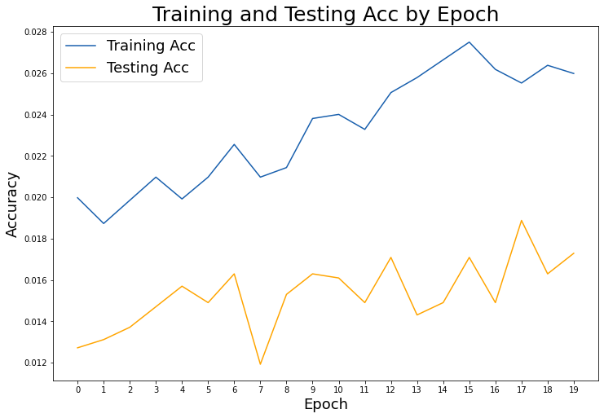
More MODELING
Next 20 epochs

Slide 18
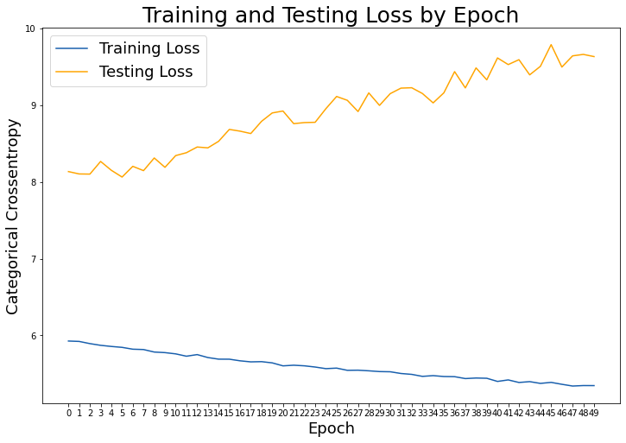
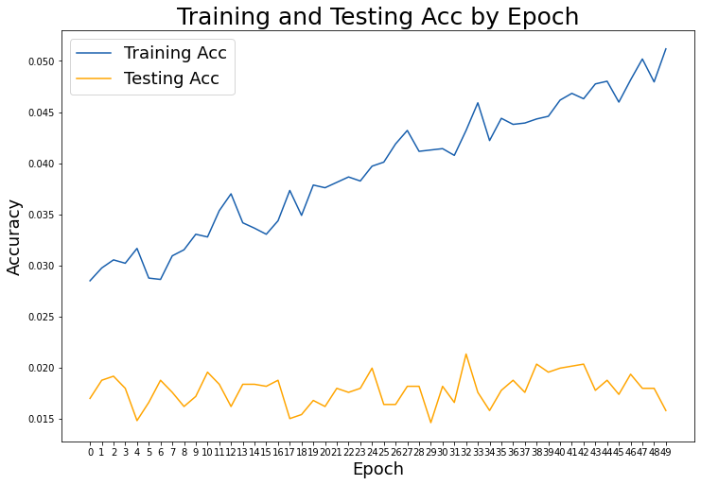
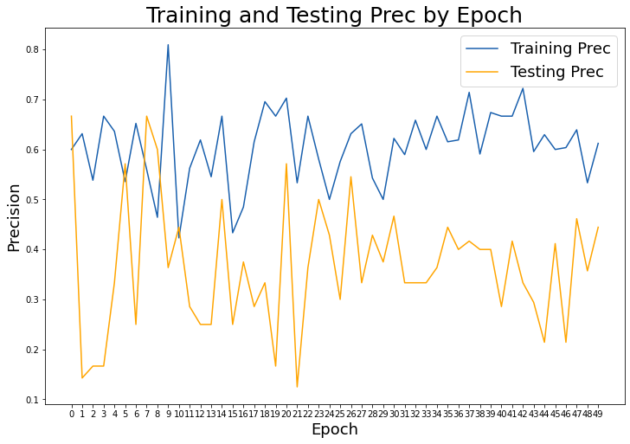
More MODELING
Final 50 epochs

Slide 19
Logistic regression
9.62%
1.78%
L
Out of the box, , saga solver, no regularization, no data augmentation
TRAINING ACCURACY
VALIDATION ACCURACY
Notes:
Logistic regression handles large amounts of data, it was actually within scope to run a fit with all our data, so a kaggle submissino is in progress.

Slide 20
Conclusion
PROJECT
Hotel recognition posed unique challenges. It required that our models learn both the shared and specific characteristics.
PROJECT
PROJECT

Slide 21
recommendationS
Utilize top K accuracy as the evaluation metric setting K = {1,10,100}.
Use clusters as additional feature for CNN
Utilize pre-trained models
Don’t try to fit on 97,000 images on CPU
Don’t underestimate the size and complexity of the problem statement
Don’t assume all Kaggle submission processes are the same

Slide 22
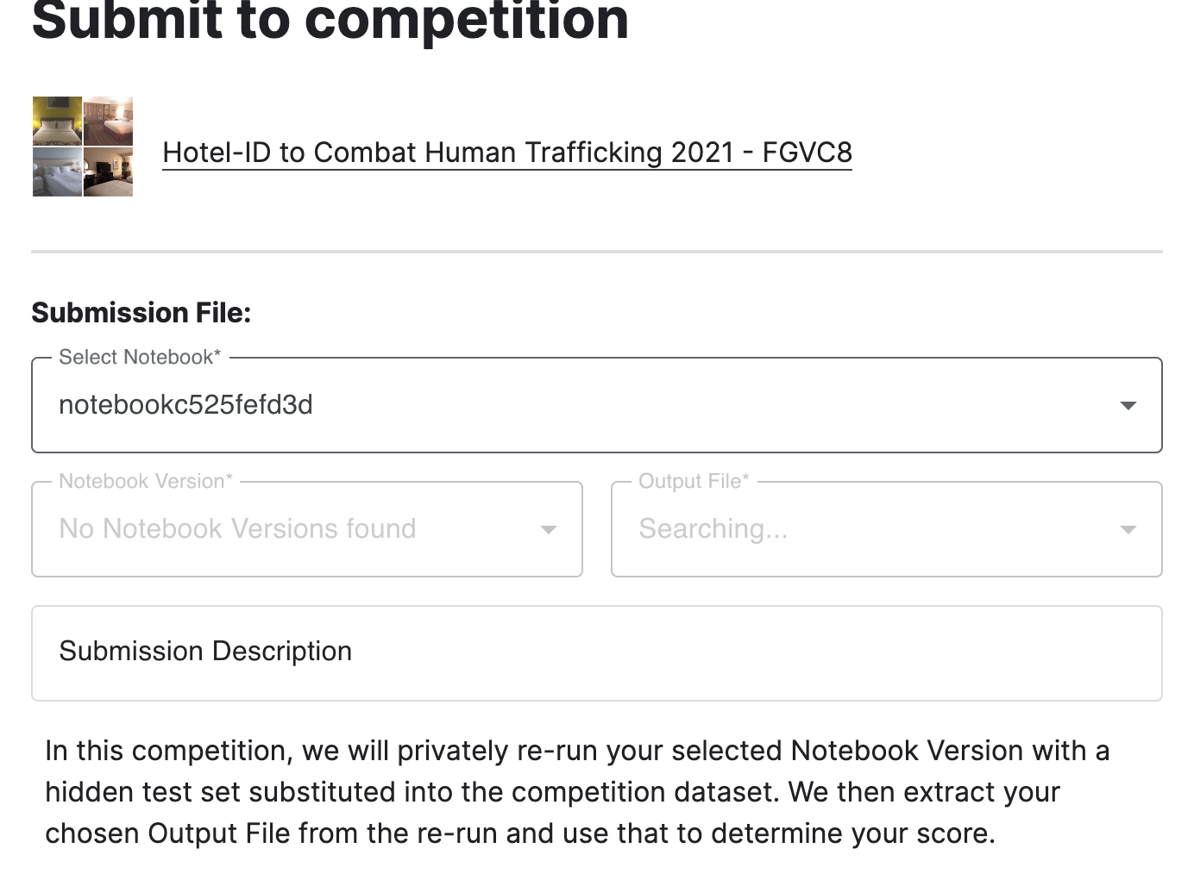
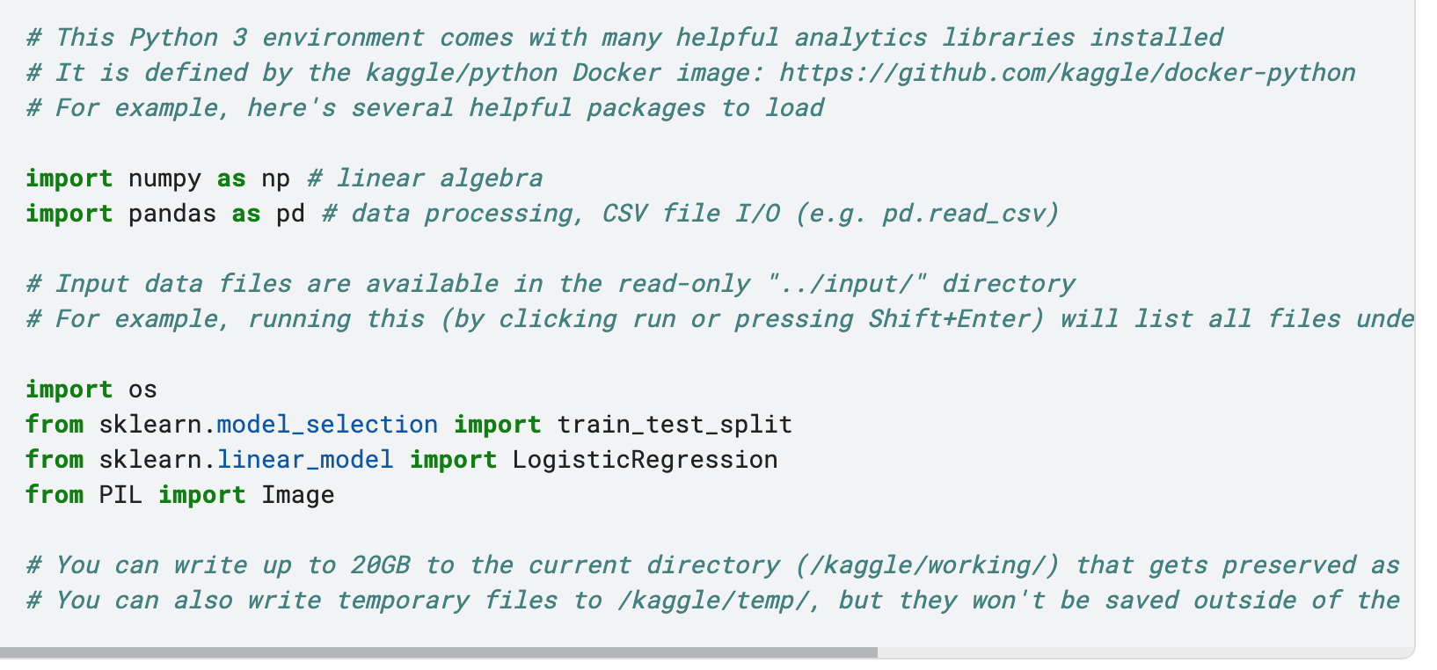
Kaggle Submission surprise

Slide 23

References
A Gentle Introduction to Batch Processing in Keras
Logistic Regression For Image Classification
Clustering images based on visual similarity
TensorFlow.org

